Slide 1

Research Data Management Platform
Health Informatics Centre

Slide 2
RDMP Data Linkage Services Core Features
Data
Repository
Data Feeds
(e.g. SMR01, Vascular Lab)
RDMP Data Load & Curation
RDMP Cohort Builder
RDMP
Project Extraction Services
Anonymous
Extract
(Plus Metadata)
Cohort
Features
Audit
Release
Documents
Reproducibility
Validation
Drag and Drop
Summarisation
Governance
SQL Code Management
Extraction Policy Management

Slide 3
RDMP Data Linkage Services Core Features
Data
Repository
Data Feeds
(e.g. SMR01, Vascular Lab)
RDMP Data Load & Curation
RDMP Cohort Builder
RDMP
Project Extraction Services
Anonymous
Extract
(Plus Metadata)
Cohort
Features
Audit
Release
Documents
Reproducibility
Validation
Drag and Drop
Summarisation
Governance
SQL Code Management
Extraction Policy Management

Slide 4
RDMP Demo Break

Slide 5
RDMP Data Linkage Services Core Features
Data
Repository
Data Feeds
(e.g. SMR01, Vascular Lab)
RDMP Data Load & Curation
RDMP Cohort Builder
RDMP
Project Extraction Services
Anonymous
Extract
(Plus Metadata)
Cohort
Features
Audit
Release
Documents
Reproducibility
Validation
Drag and Drop
Summarisation
Governance
SQL Code Management
Extraction Policy Management

Slide 6
RDMP Demo Break

Slide 7
Advanced Cohort Example

Slide 8
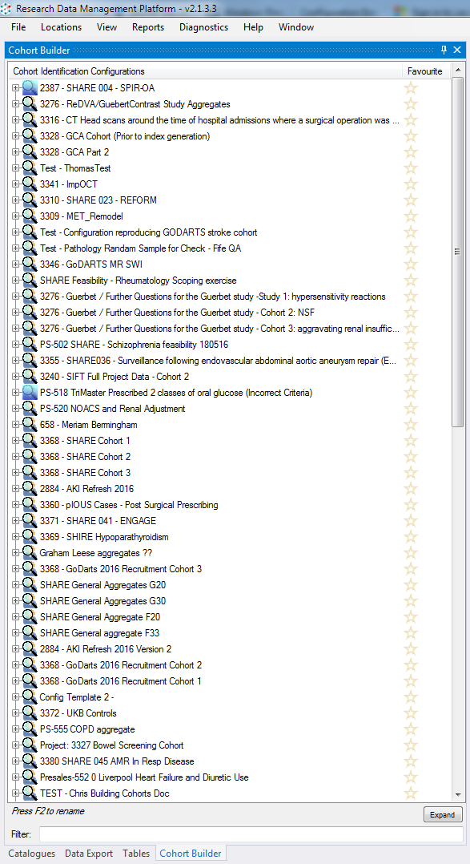
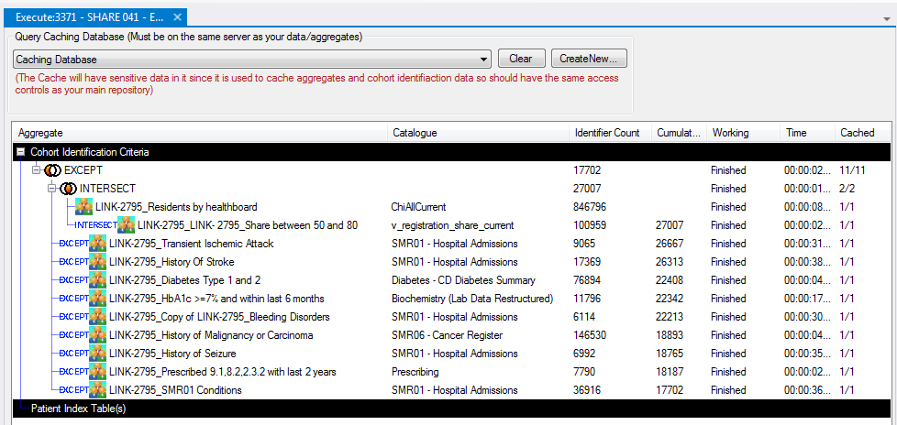

Slide 9
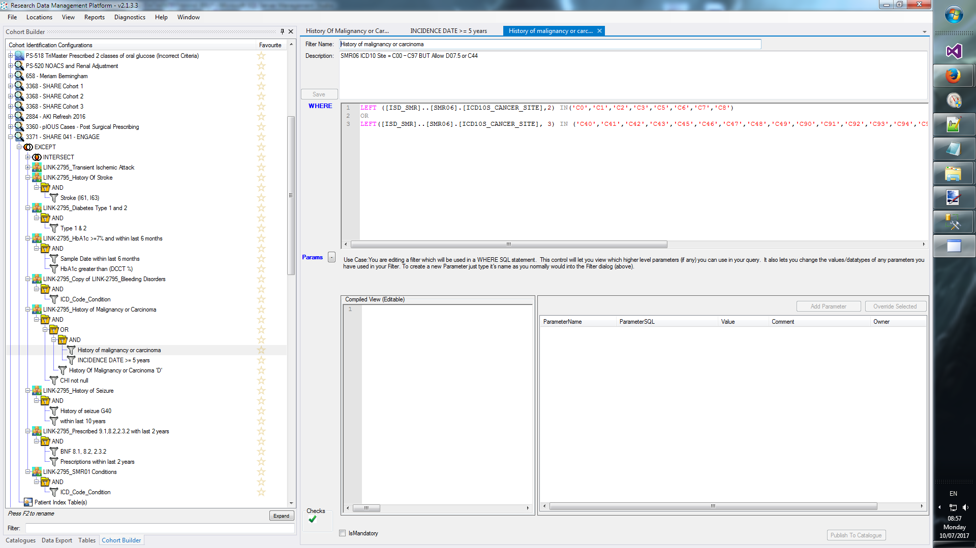

Slide 10
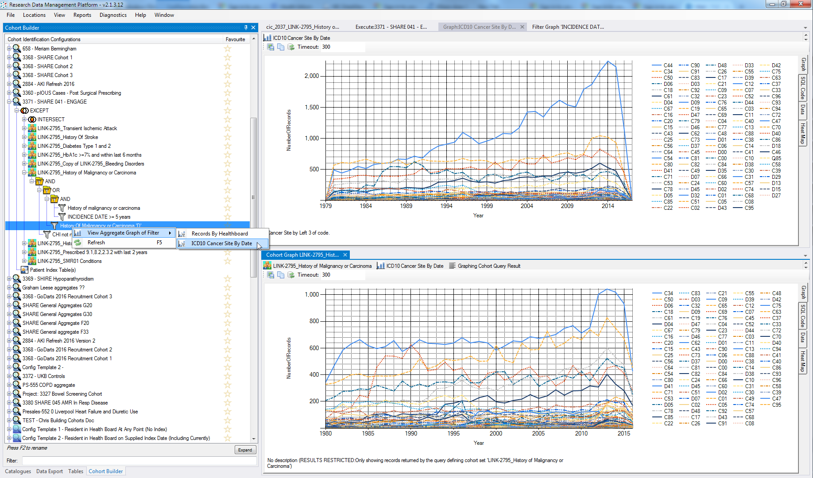

Slide 11
RDMP Data Linkage Services Core Features
Data
Repository
Data Feeds
(e.g. SMR01, Vascular Lab)
RDMP Data Load & Curation
RDMP Cohort Builder
RDMP
Project Extraction Services
Anonymous
Extract
(Plus Metadata)
Cohort
Features
Audit
Release
Documents
Reproducibility
Validation
Drag and Drop
Summarisation
Governance
SQL Code Management
Extraction Policy Management

Slide 12
RDMP Demo Break
Import File, Configure column extracts, anonymization, documentation

Slide 13
Data Set and Extraction Policy Management
Dataset Extraction Rules
Which columns are extracted
Which columns require special approval
Which columns are Never Extractable
Mandatory Filtering (only extract Tayside and Fife Healthboards)
Predefined filter templates
Anonymisation Rules (project specific):
Dilution ( DD1 ), Hashing (fe34ga7345) and Substitution ( T1010 -> A23299)
Dashboard Aggregates Graphs
Quality Metrics (e.g. CHI 100%, Condition Codes > 90%)
Important Meta data document attachments

Slide 14
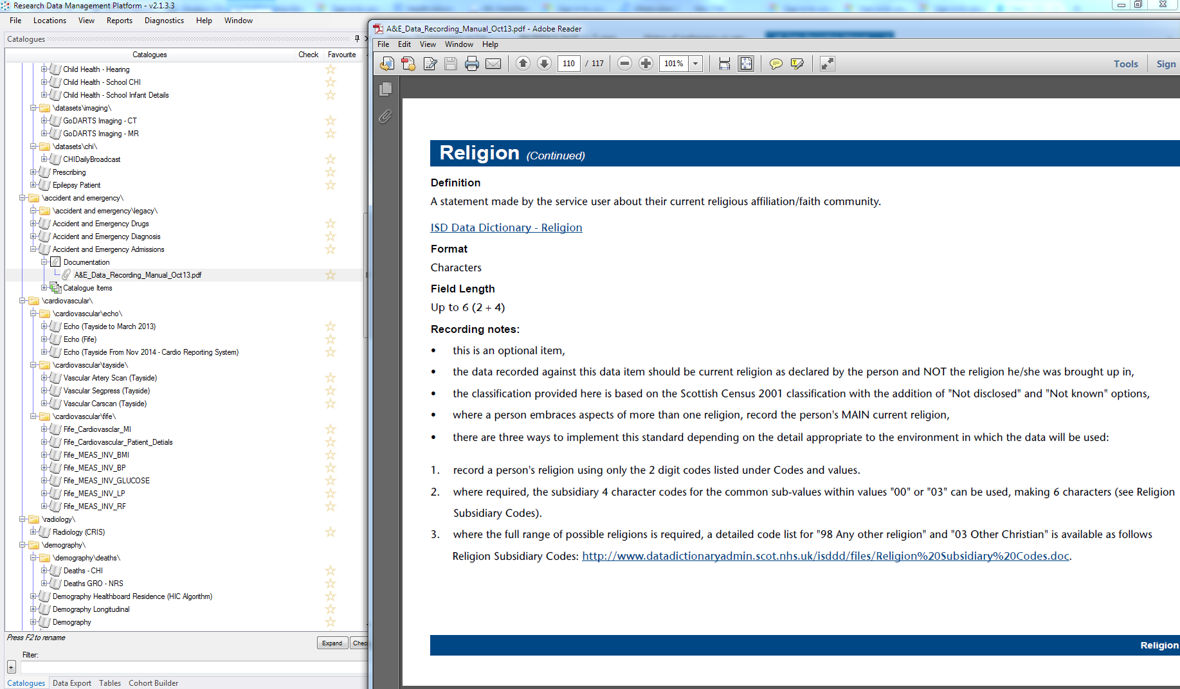

Slide 15
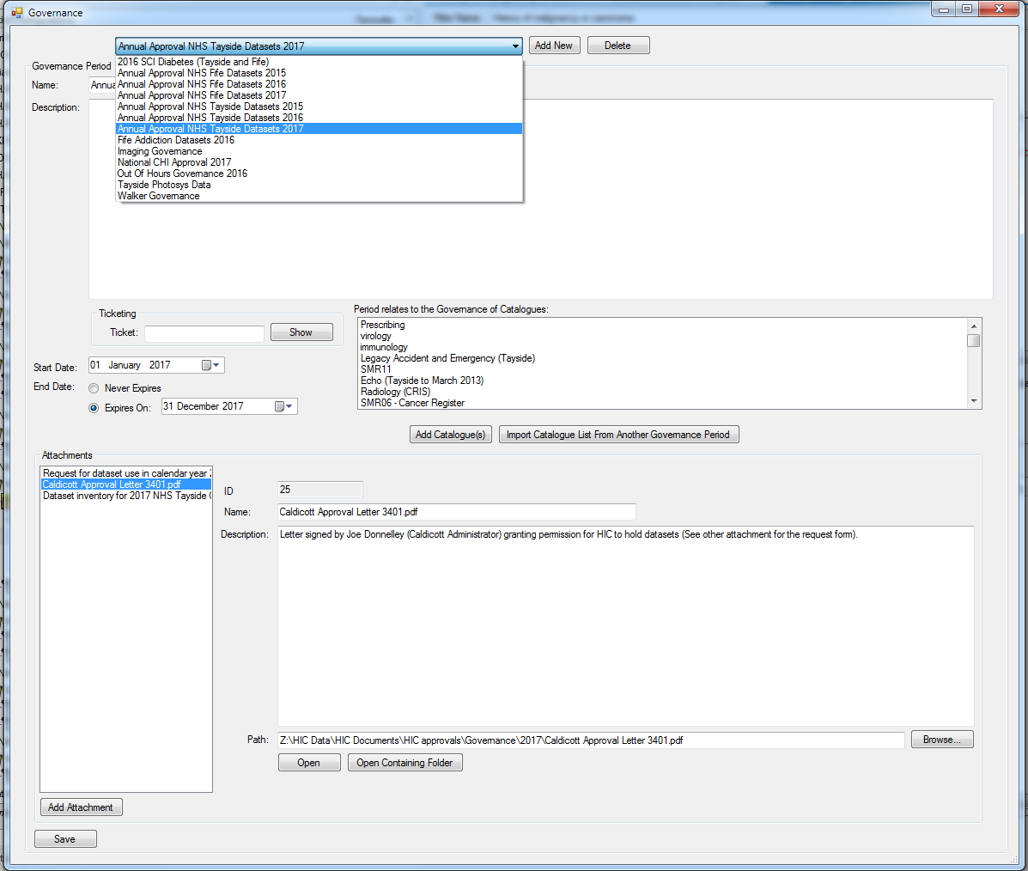

Slide 16
Audit
Every Extraction, Data Load, Data Quality Engine run etc
Extraction Queries
Number of records extracted / loaded etc
Who performed action
Extract location
MD5

Slide 17
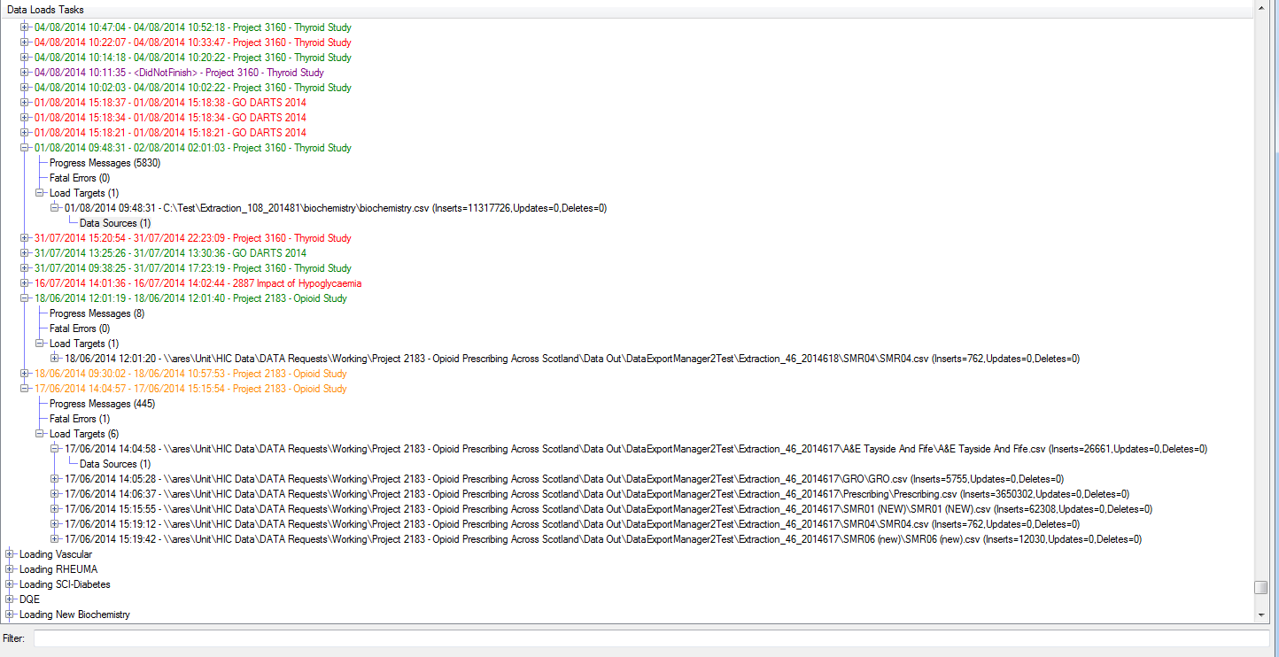

Slide 18
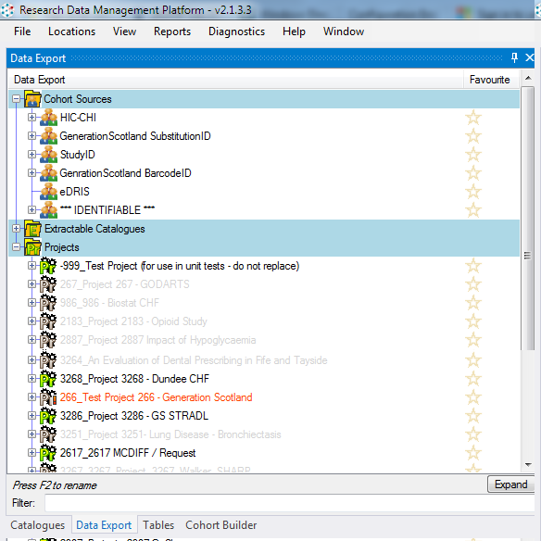
CHI => PROCHI
CHI => Generation Scotland ID
CHI => eDRIS Identifier
Released Projects
Projects with active extracts being built

Slide 19
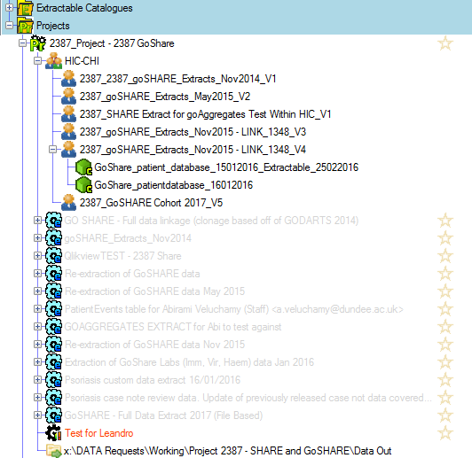
Within a Project:
Multiple cohort snapshots over time
Project/Cohort Specific Data Tables
Configurations (which datasets were extracted)
Were there any filters?

Slide 20
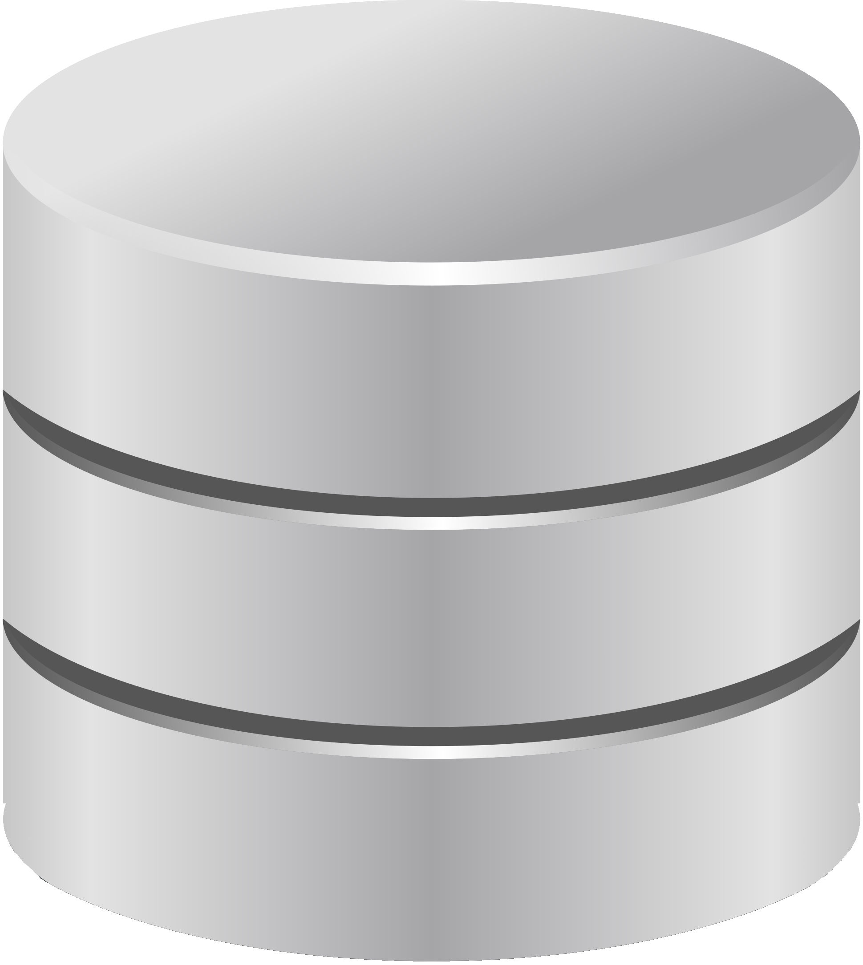
Human readable description
Groups longitudinal record of what has been extracted
Project
Extractable Cohort
Cohort Identification Configuration
Human readable description
Extraction Configuration
Finalized list of patients
Anonymous release identifier mapping
Groups sets of patients e.g. exclusion criteria
Includes set operation e.g. INTERSECT / UNION
Cohort Aggregate Container
Which datasets are selected for extraction
What filters are applied (when extracting records)
What cohort is linked against
Aggregate Configuration
Uses a Catalogue to identify a subset of patients
Can contain one or more filters with AND/OR logic
ExtractableDataset
Marks a Catalogue as extractable in projects
Load Metadata
Catalogue
Human readable description
Validation rules
How one or more Catalogues are loaded
Sequence of configurable components e.g. load CSV file to RAW
Catalogue Item
Human readable description
Extraction Information
How column is extracted
Governance (e.g. Special Approval Required)
Contains Patient Identifiers?
Table Info
Caches state
Can store access credentials
Extraction Filter
How to use the column reduce the dataset (e.g. Health board is ‘Tayside’)
Human readable description
Column Info
Column Info
Caches state
Database
MySql / Sql Server / Oracle

